Slide 1
The State of our Climate
Understanding our role in a changing atmosphere
Logan Voellinger

Slide 2
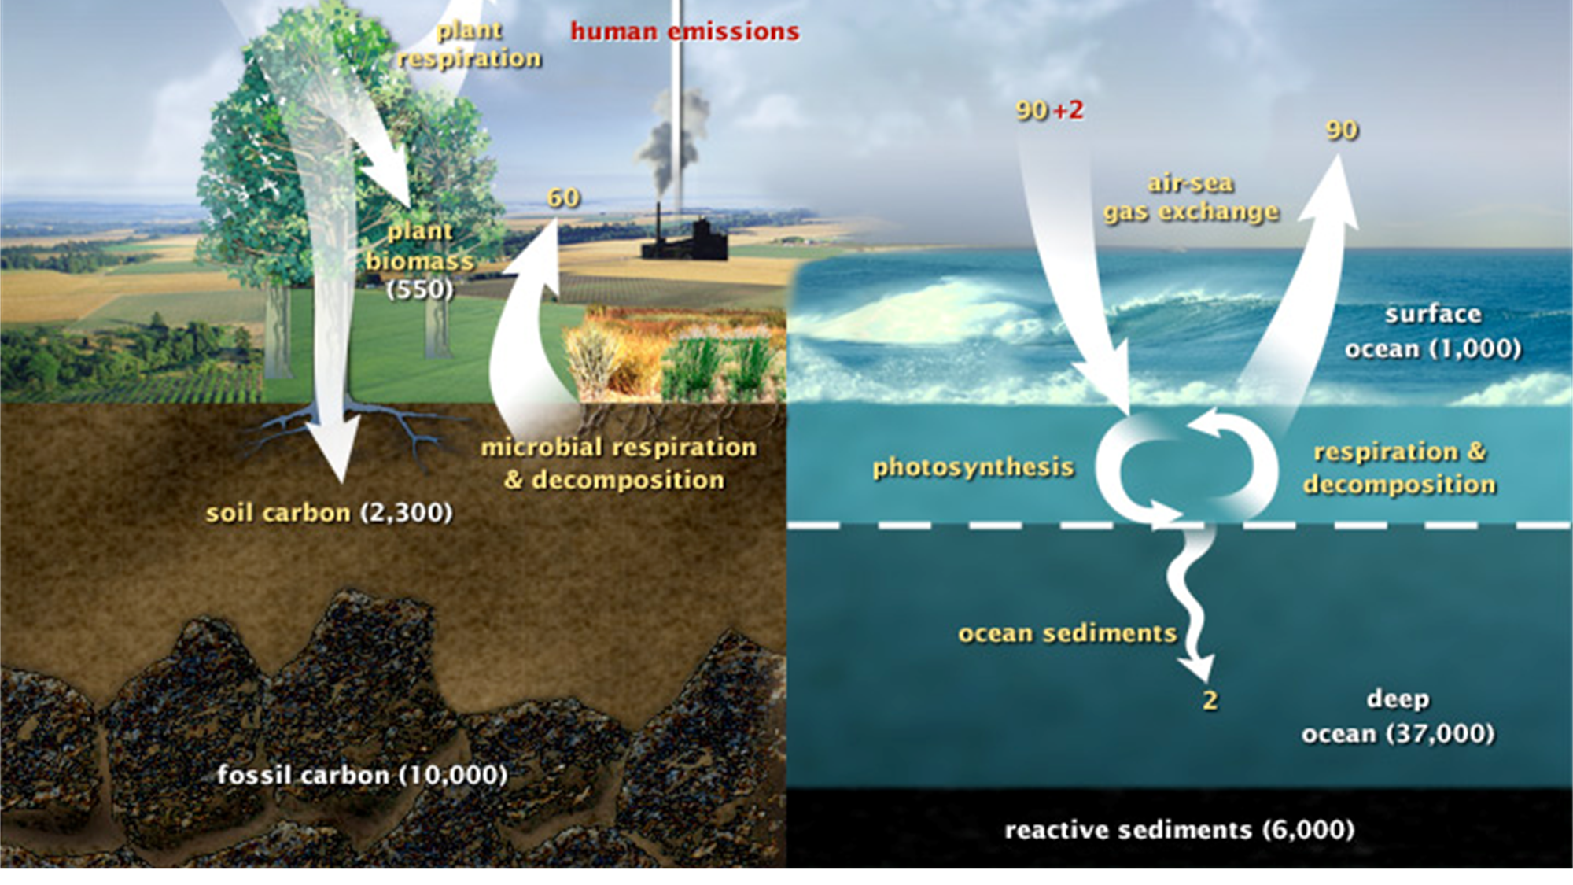
The Carbon Cycle
Notes:
First off, I’d like to start with a real quick overview of the Carbon Cycle. The carbon cycle describes the process in which carbon atoms continually travel from the atmosphere to the Earth and then back into the atmosphere. Our planet and its atmosphere form a closed system, meaning the amount of carbon in the system doesn’t change. Meaning we’re not losing hardly any of our carbon to outer space- it’s trapped in our atmosphere, where it waits to re-enter the cycle. Where the carbon is located — in the atmosphere or on Earth — is constantly in flux- but in addition to this constant give and take with the land, oceans, and our atmosphere, a relatively small but steady trickle makes its way to what we call a carbon Sink or Reservoir, where it is mostly locked away out of the typical cycle, usually as organic matter decomposes or soil and other sediments settle to the ground and slowly get buried. This slow trickle may have captured quite a bit of carbon over the past few billion years, but we’ll be taking a closer look at how humans have disrupted this balance since the industrial age, once we found a way to extract carbon from the fossilized carbon sink and put it to use.

Slide 3
Carbon Sinks
Carbon reservoirs that accumulate over time, storing carbon outside of typical atmospheric carbon cycles.
Deep oceans
Soils/rocks
Plants & animals (while they’re alive)
Fossils/non-decomposed organic matter (oil)
Relatively inaccessible, and stay “locked away” until…
Fires
Volcanoes
Humans dig them up and burn them
Notes:
Like you saw in the previous slide, the major categories of ‘carbon sinks’ are the deep ocean and all of it’s sediments, soils and rocks, and all living things (plants and animals)- as well as fossil fuels locked away in liquid reservoirs underground.
There really aren’t too many mechanisms that release Carbon from these sinks back up to the atmosphere on a measurable scale aside from fires and volcanoes- that is, until humans figured out how to access and utilize carbon stored in rocks (by burning coal)- and the large pools of oil under the earth’s surface that took millions and millions of years to accumulate.

Slide 4
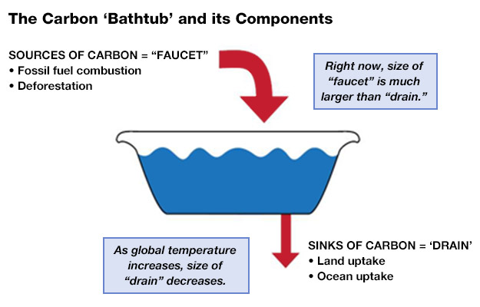
The Current Balance
Notes:
A helpful way to illustrate how humans are impacting the carbon cycle generally is to picture a bathtub. For hundreds of thousands of years, this bathtub faucet has remained partially open, while the partially opened drain maintained a relatively steady water level that ebbed and flowed in cycles we’ll see on a later slide- but since the industrial age, we’ve opened that faucet to release more of that “water” into our “tub” without changing how quickly it drains to our carbon sinks- in fact, our drain has been working slower as global temperatures increase, as warmer oceans absorb less CO2.

Slide 5
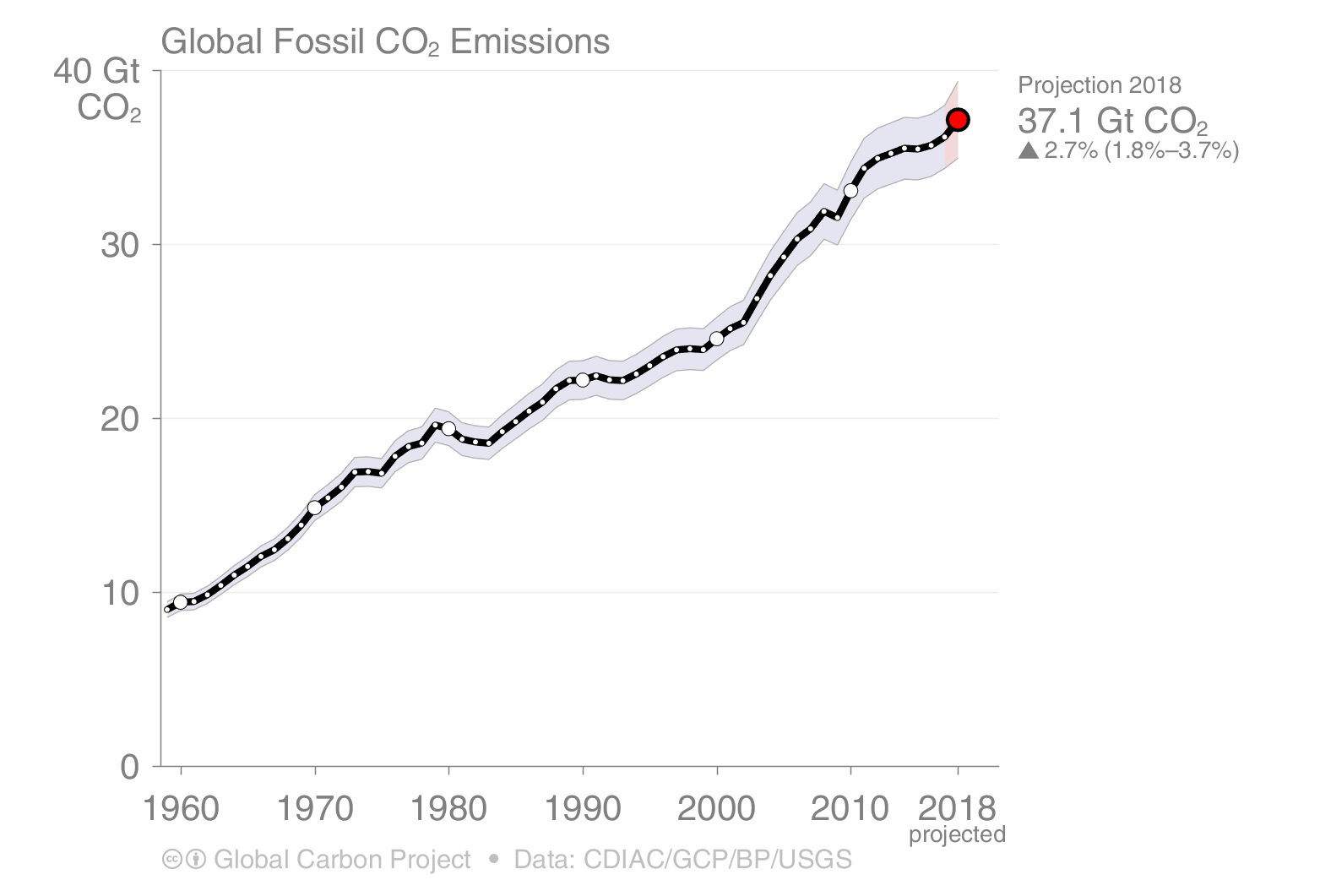
Exactly How Much do we Emit?
= 37.1 Billion tons (2018)
(= 37,100,000,000,000 kg CO2)
(= 715,075,000,000,000 ft³ CO2)
Notes:
I just wanted to show with this graph just how much our human emissions have changed over the course of just 60 years- a trend that has shown no signs of slowing down… that is to say, we have only been opening that faucet more and more as time has gone on.

Slide 6
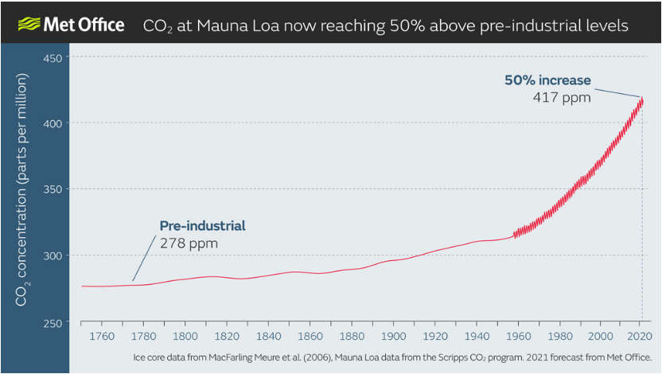
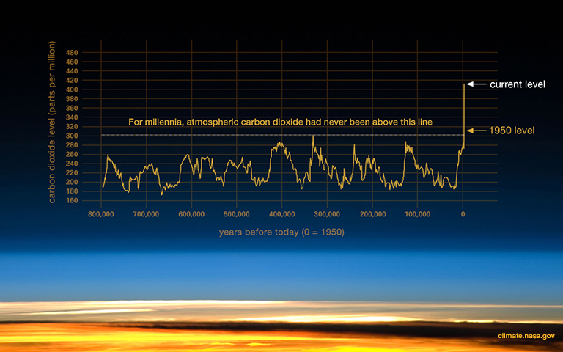
Atmospheric CO2 over the Years
Global Population:
~750 million
Global Population:
~8 billion
climate.nasa.gov
Notes:
This graph, in my opinion, tells one of the scariest stories of how drastically and how quickly humans have impacted atmospheric CO2 levels. You can see these levels have constantly been changing over the last million or so years, where they hovered right until the industrial revolution began and the human population began to flourish. It’s worth noting that through all of these ebbs and flows, we’ve seen ice ages, sea levels 50 feet above present, (tropical-feeling temperatures on the planet’s polar regions- meaning no ice caps), and high enough volcanic activity that the earth’s ecosystem drastically changed- further affirming carbon is a fundamental factor in our planet’s overall climate.
When we zoom in to these last few hundred years, we get a clearer picture of how and when these numbers began to shift the way they did- namely corresponding to the industrial era and an exponentially-growing population.

Slide 7
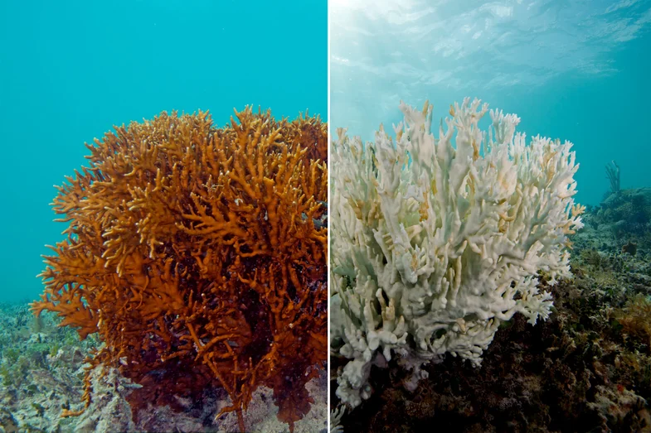
OK, there’s a lot more Carbon in the air. So What?
Increased atmospheric Carbon => increased surface temperatures
Greenhouse Gases in the atmosphere block radiative heat loss
More frequent extreme weather events (droughts, floods, hurricanes, heat waves, fires)
Rising sea levels due to melting glacial ice (ice that reflects the sun’s heat energy!)
Ocean Acidification
pH decreases (acidifies) as it intakes CO2
Drastically impacts corals and shellfish
Loss of algae that provides ~90% of coral’s energy supply (bleaching)
Water Problems, Food Problems, Ecosystem Problems
“Climate refugees” due to water and food security issues
Shifting agricultural zones/habitable zones
Mass plant and animal migrations (and extinctions) due to ecosystem changes and loss
Notes:
I don’t have the time to dive into any of these issues individually; experts dedicate their whole lives to studying the extent to which these problems will affect different parts of the globe, but not the fact that they’re happening.
But, like I mentioned earlier- all of this carbon we’re burning is going straight up to our atmosphere and accumulating there- not shooting off into outer space, it’s too heavy- but rather it’s forming a type of blanket, in a way, that traps the heat on the earth’s surface much like clouds do on a smaller scale (although the sun still shines through the carbon in the air unlike the cloud).
Some of you may have heard the term Ocean Acidification- this describes essentially the same concept of carbon accumulation that’s happening in our atmosphere, but in our oceans. Ocean life can be extremely sensitive to small changes, particularly animals with shells that are severely degraded in this higher pH environment.
I also like to point out that this is going to very much be a human problem as well- as populations will need to adapt to changing environmental conditions, whether they live on a small island nation or an arid desert-climate with water supplies that are gone or re-routed to higher priority areas.
When it’s my turn to think of retirement ((by 2050)) Salt Lake’s climate is projected to resemble that of Las Vegas (and Phoenix will resemble modern-day Baghdad)

Slide 8
Notes:
Relieable instrumental temperature records began in 1880

Slide 9
Greenhouse Gases over the Years
Methane
Warming Potential = 86x
CO2 equivalent (over 20 yrs)
Methane lifespan: ~10yrs
(then converts to CO2 and H2O, which are both greenhouse gases)
Nitrous Oxide
Warming Potential = 298x
CO2 equivalent (over 100 yrs)
N20 lifespan: ~114 yrs

Slide 10
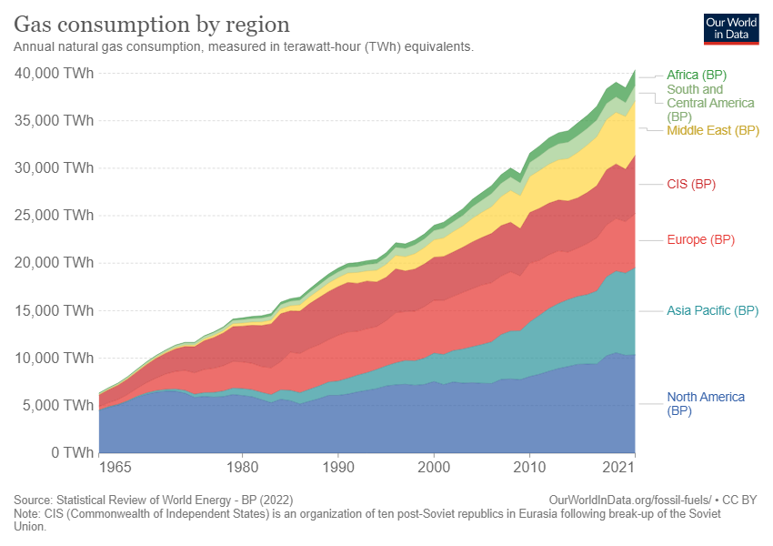
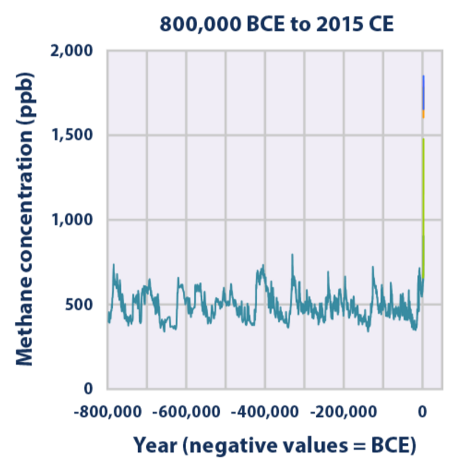
Methane on the Rise
Notes:
Methane’s lifespan in atmosphere is about 10 years, but there’s no sign of anthropogenic emission rates slowing down.

Slide 11
More Humans means More Emissions
Notes:
Our population has been growing by almost 1 billion people each decade since 1975; some models show this growth rate finally slowing down some in the past few years.
The world population doubled from 1960 to 1999 (3 billion people)

Slide 12
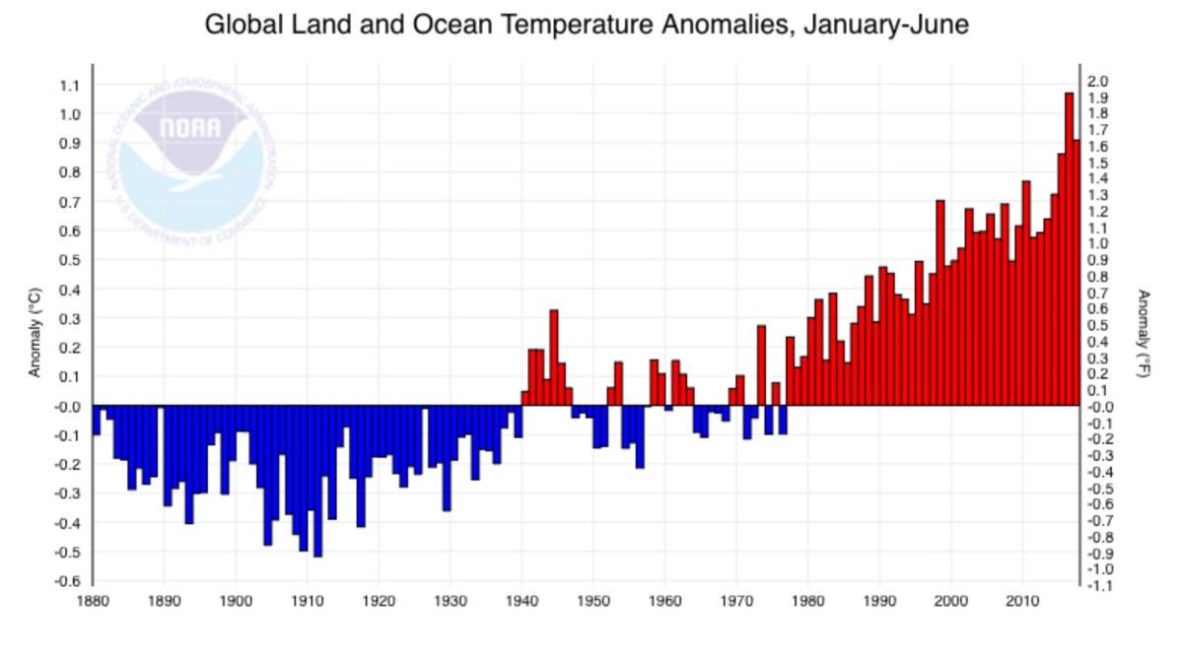
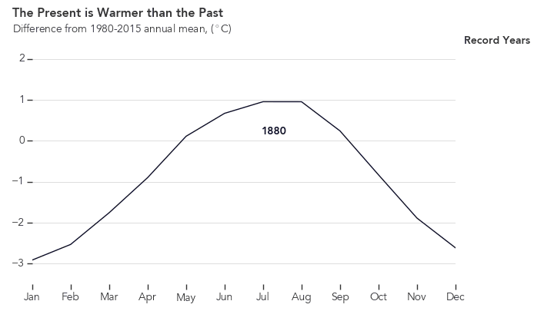
It’s Getting Hot in Here

Slide 13
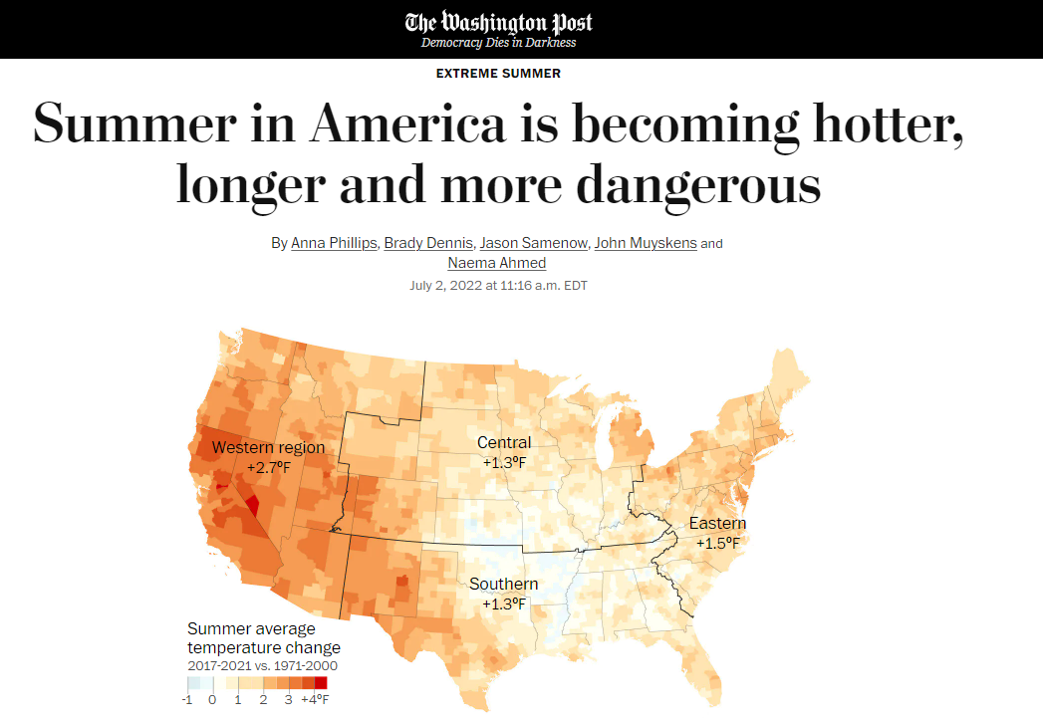
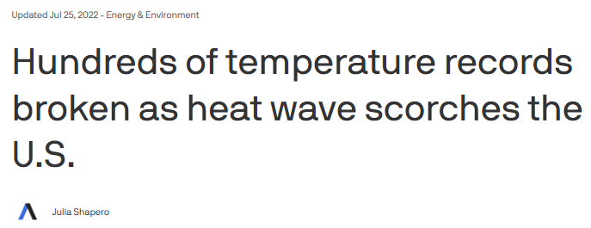
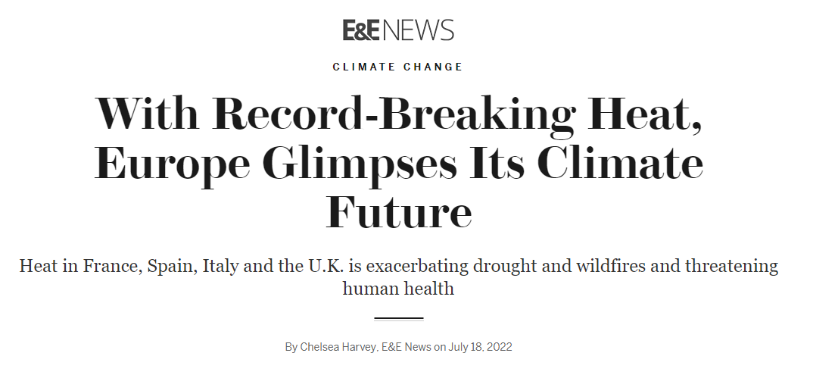
It’s Getting Hot in Here

Slide 14
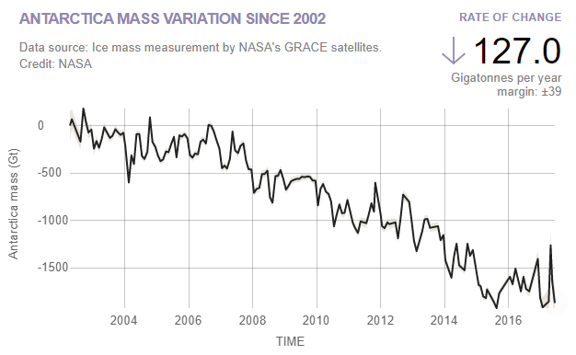
Ice is Melting (Faster and Faster)
Land ice sheets in both Antarctica (left) and Greenland (right) have been losing mass since 2002.
Both have seen an acceleration of ice mass loss since 2009.
Notes:
Scientists conducting research in the Canadian arctic are discovering mosses that have been buried in ice for about the last 50,000 years

Slide 15
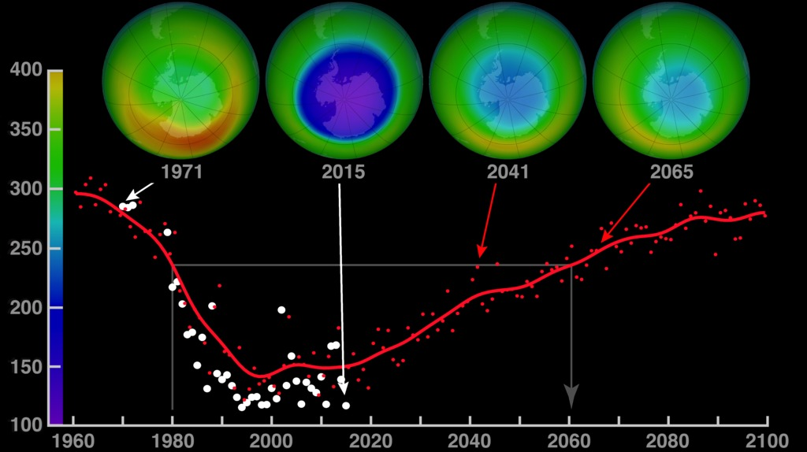
We Can Have an Impact
Ozone levels stabilized in the 1990s following the 1987 Montreal Protocol, and have started to recover. They are projected to reach pre-1980 levels before 2075
Production of CFCs frozen at 1986 levels; countries agreed to reduce production by 50% by 1999
(1976 report by the US National Academy of Sciences concluded that ozone was depleting)
Notes:
ozone layer absorbs UVB ultraviolet light from the sun, ozone layer depletion increases surface UVB levels (all else equal), which could lead to damage, including increase in skin cancer.
The United States banned the use of CFCs in aerosol cans in 1978.^{[62]} The European Community rejected proposals to ban CFCs in aerosol sprays, and in the U.S., CFCs continued to be used as refrigerants and for cleaning circuit boards. Worldwide CFC production fell sharply after the U.S. aerosol ban, but by 1986 had returned nearly to its 1976 level
An ozone-safe hydrocarbon refrigerant was developed at a Hamburg technological institute in Germany, and in 1992 came to the attention of the non-governmental organization (NGO) Greenpeace. Greenpeace was given the patent, called it "Greenfreeze," and left the patent as open source

Slide 16
EPA Clean Air Act
Before President Richard Nixon created the Environmental Protection Agency in 1970, water and air pollution weren't federally regulated
Between 1971 and 1977, the EPA enlisted 100 photographers to document the conditions of the country and the environment with "The Documerica Project."

Slide 17
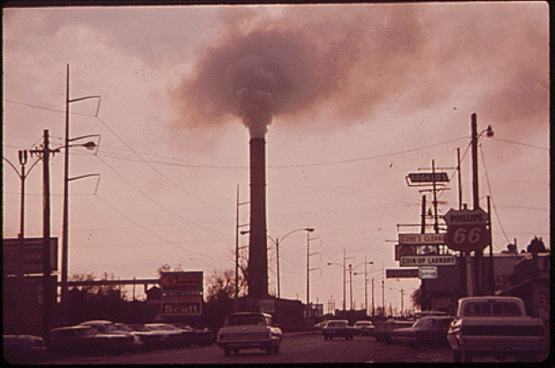
In New Orleans, toxic fumes spread over the streets, billowing out from Kaiser Aluminum Plant's smoke stack.

Slide 18
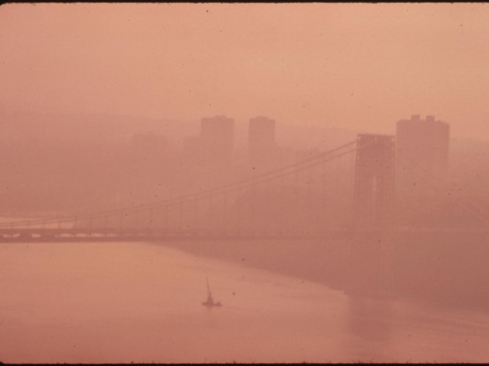
The George Washington Bridge going over the Hudson River, covered in thick smog. In 1965, a study by New York City Council found breathing New York's air had the same effect as smoking two packets of cigarettes a day.

Slide 19
A house in North Birmingham is barely visible in industrial smog coming from the North Birmingham Pipe Plant. It was the most polluted area of the city.

Slide 20
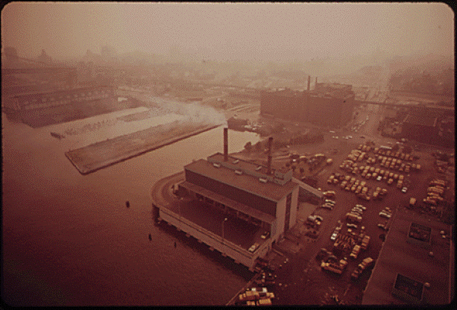
In Delaware, the city incinerator billows out smoke over the river. In 2016, a report released by New York University said 41 people living in Delaware still die because of air pollution every year.

Slide 21
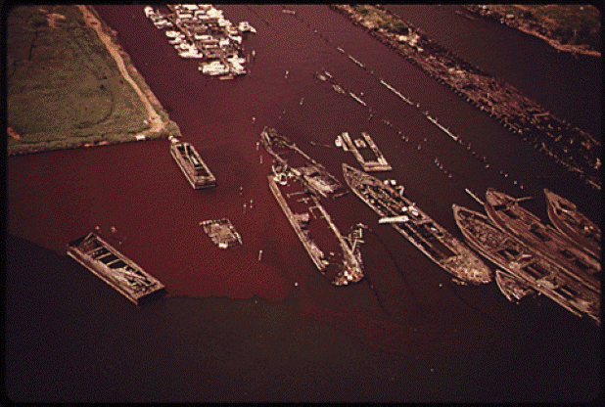
In Bayonne, New Jersey, raw and partially digested sewage can be seen darkening the water.

Slide 22
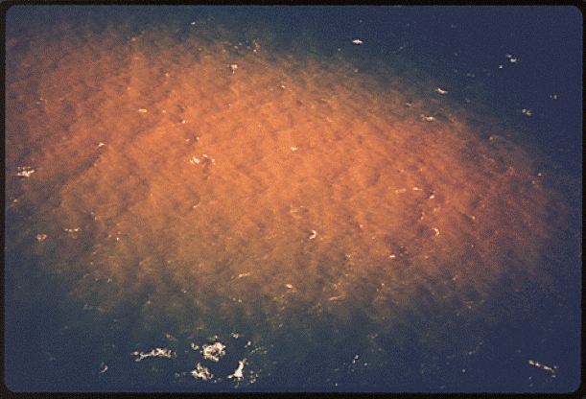
Here, acid waste lightens the water. Acid waste was also dumped in the New York Bight, 15 miles off-shore. In 1974, more than 3 million tons were dumped in the Bight. It is estimated about 6 million gallons of coal were dumped into the New York Bight by the Edison Power Plant in Manhattan in the early 1970s.

Slide 23
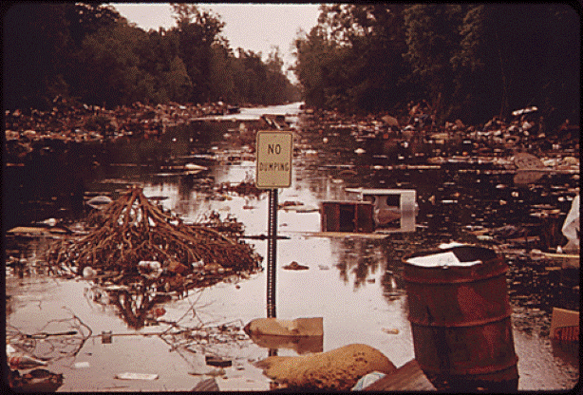
In an illegal dump in New Orleans, garbage turned to sludge when a lake overflowed into it. In the 1970s, the EPA found 66 pollutants in the city's drinking water. And the city's water is known for its oily taste.

Slide 24
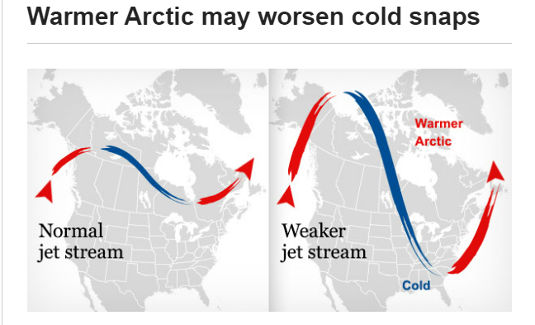
Common Anti-Climate Change Arguments
Not all scientists agree in human-caused climate change!
Over 98% of climate scientists agree humans are driving climate change
(Just like 97% of scientists agree smoking causes cancer)
The climate has always been changing since before there were humans!
True, but… these cycles occur over hundreds of thousands of years, not decades.
(“Smoking doesn’t cause cancer, people have always gotten cancer!”)
Don’t forget: mass extinctions, ice ages, and inhospitably hot conditions have also occurred
What about all these record cold temperatures and snowfalls? So much for Global Warming!
More snowfall during winter storms is an expected effect of climate change
Average global annual temperatures are still increasing
Cold, polar air is reaching further south than normal in the US and Europe (polar vortex)

Slide 25
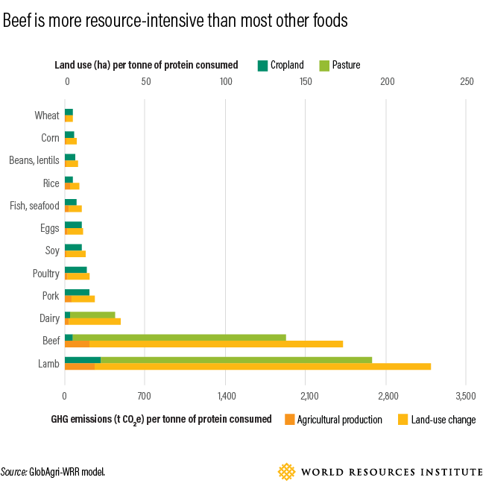
What Can I Do?
Cut the beef (and lamb) – Shop for food produced locally!
Get your electricity from Green Sources/incentive programs
Reduce plastic consumption (refill a water bottle!)
Don’t use fuel-inefficient vehicles (or airplanes)
Be informed on the science
Almost everything is more complex than it seems

Slide 26
References
https://archive.epa.gov/epa/climate-change-science/causes-climate-change.html
https://climate.nasa.gov/vital-signs/ice-sheets/
https://www.epa.gov/ghgemissions/global-greenhouse-gas-emissions-data
https://www.eia.gov/todayinenergy/detail.php?id=5810
https://www.wri.org/blog/2019/04/6-pressing-questions-about-beef-and-climate-change-answered
https://www.epa.gov/history/historical-photos-and-images

Slide 27
Questions?

Slide 28
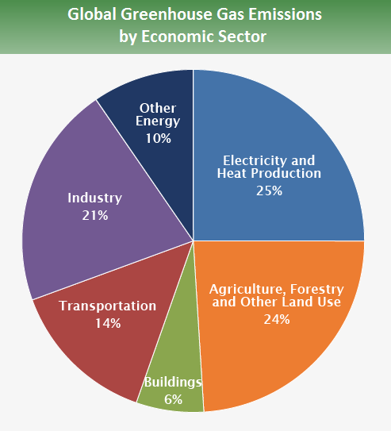
Where are the emissions coming from?
(2010 data)
Approximately 20% offset by plant growth,
soil sequestration,
dead organic matter
Source: IPCC (2014)
Notes:
industry primarily involve fossil fuels burned on site at facilities for energy. This sector also includes emissions from chemical, metallurgical, and mineral transformation processes not associated with energy consumption and emissions from waste management activities. (Note: Emissions from industrial electricity use are excluded and are instead covered in the Electricity and Heat Production sector.)
Transportation: fossil fuels burned for road, rail, air, and marine transportation. Almost all (95%) of the world's transportation energy comes from petroleum-based fuels, largely gasoline and diesel.
Buildings: onsite energy generation and burning fuels for heat in buildings or cooking in homes. (Note: Emissions from electricity use in buildings are excluded and are instead covered in the Electricity and Heat Production sector.)
Other Energy: sector which are not directly associated with electricity or heat production, such as fuel extraction, refining, processing, and transportation.

