Slide 1
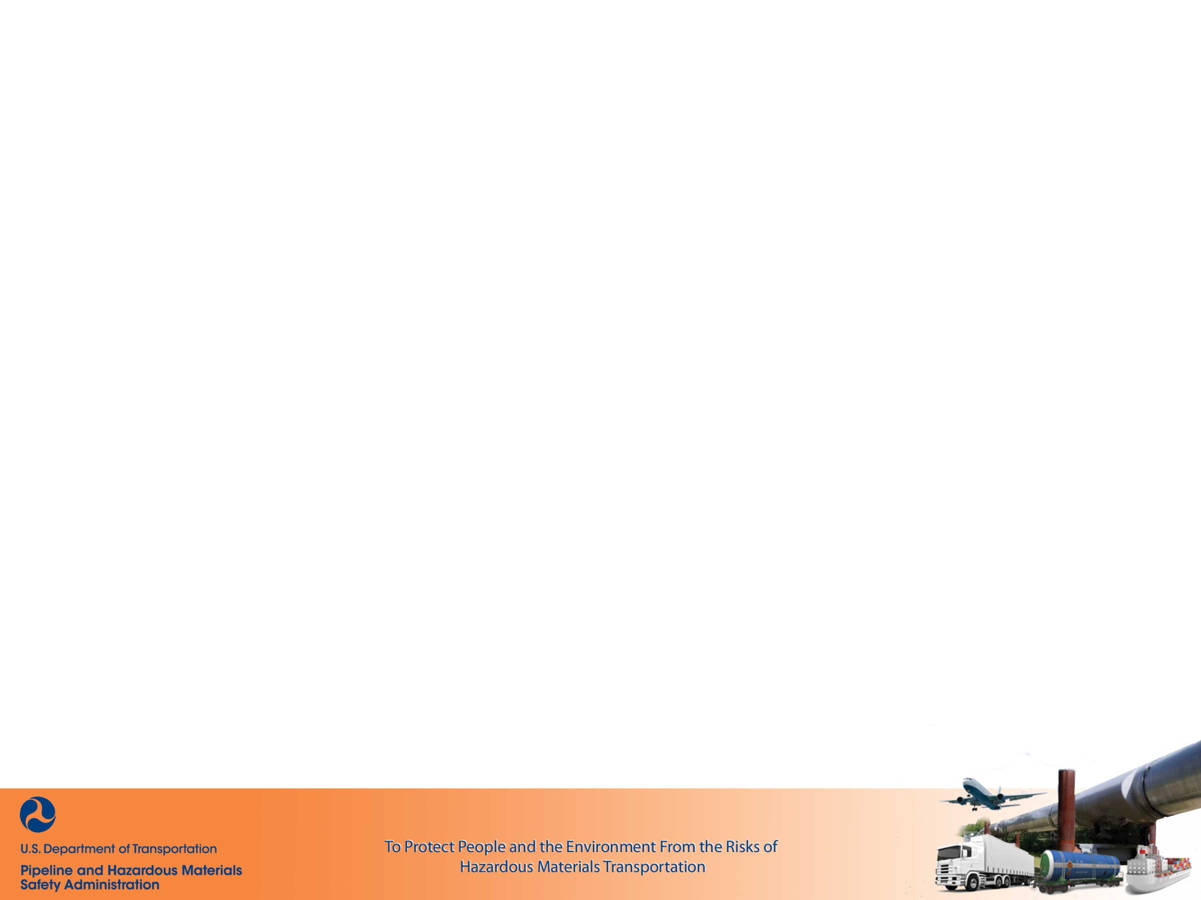
Valve Installation and Minimum Rupture Detection Standards
A.K.A – The “Valve Rule”

Slide 2

Tyler Dean
Training Instructor, PHMSA Training & Qualifications
(405) 627-6752 (Mobile)
tyler.dean@dot.gov

Slide 3
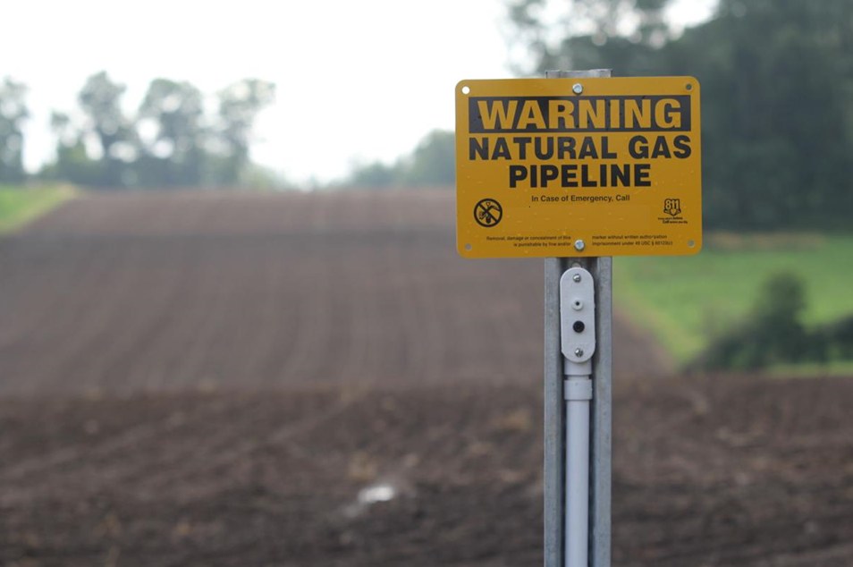
Why did this Rulemaking Occur?

Slide 4
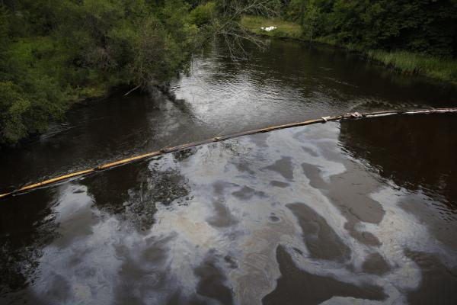
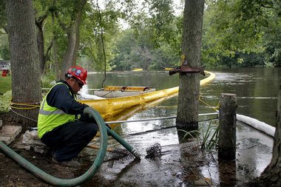
Marshall, MI
July 25, 2010 –
  19000 BBL (800,000 gallons) of Crude Oil
  $1 Billion in Property and Environmental Damage
  18 hrs from Initial Alarm
Notes:
July 25, 2010, in Marshall, MI, resulting in a release of approximately 800,000 gallons of crude oil into the Kalamazoo River and approximately $1 billion in property and environmental damages.
The operator, Enbridge Energy, LP (Enbridge), took 18 hours to confirm the pipeline rupture following the initial alarms received by the control room operators. Once Enbridge confirmed the rupture, the failed segment was immediately isolated using installed remote-control shut-off valves (RCV).

Slide 5
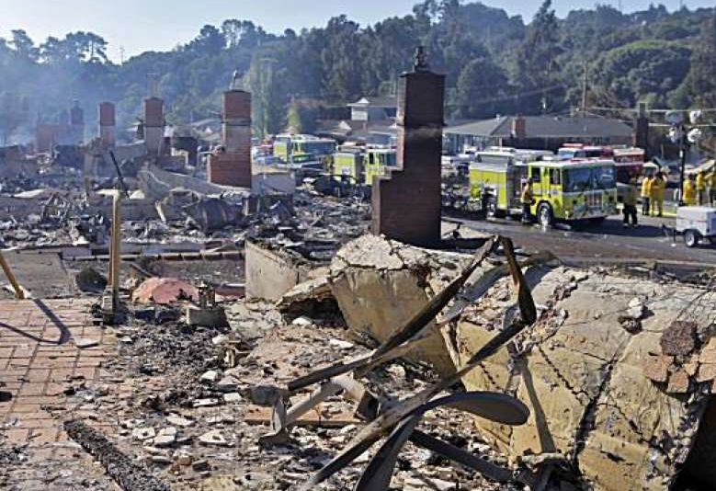
San Bruno, CA
September 9, 2010 –
  8 people killed
  51 injured
  Destroys 38 homes
  Damaged 70 homes
  47 MMCF of Gas
  95 Minutes
Notes:
September 9, 2010, in San Bruno, CA, when a gas transmission pipeline ruptured, causing an explosion that killed 8 people, sent 51 other people to the hospital, destroyed 38 homes and damaged 70 others, and caused the evacuation of approximately 300 homes. Initial 9-1-1 notification call by the public was made within one minute of the rupture, which occurred at 6:11 p.m. 95 Minutes to isolate the failed section.
47 million cubic feet of gas was released.

Slide 6
Edison, NJ
March 24, 1994 –
  1 person died
  Destroyed 8 buildings
  Evacuation of 1500 Apartments
  $25 Million in Damages
  2½ Hours
Notes:
September 9, 2010, in San Bruno, CA, when a gas transmission pipeline ruptured, causing an explosion that killed 8 people, sent 51 other people to the hospital, destroyed 38 homes and damaged 70 others, and caused the evacuation of approximately 300 homes. Initial 9-1-1 notification call by the public was made within one minute of the rupture, which occurred at 6:11 p.m. 95 Minutes to isolate the failed section.
47 million cubic feet of gas was released.

Slide 7
Pipeline Safety Act 2011 -
§60102(n)
(n) Automatic and Remote-Controlled Shut-off Valves for New Transmission Pipelines-
(1) IN GENERAL-….the Secretary, if appropriate, shall require by regulation the use of automatic or remote-controlled shut-off valves, or equivalent technology, …on transmission pipeline facilities constructed or entirely replaced after the date on which the Secretary issues the final rule containing such requirement.

Slide 8
Pipeline Safety Act 2011 -
§60102(n)
(n) Automatic and Remote-Controlled Shut-off Valves for New Transmission Pipelines-
(2) HIGH-CONSEQUENCE AREA STUDY-
(A) STUDY- …. conduct a study on the ability of transmission pipeline facility operators to respond to a hazardous liquid or gas release from a pipeline segment located in a high-consequence area.
(B) CONSIDERATIONS- ….shall consider the swiftness of leak detection and pipeline shutdown capabilities, the location of the nearest response personnel, and the costs, risks, and benefits of installing automatic and remote-controlled shut-off valves.

Slide 9
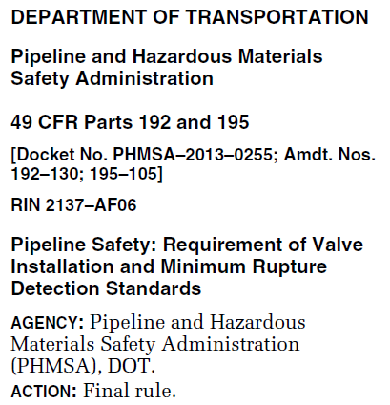
April 8, 2022

Slide 10
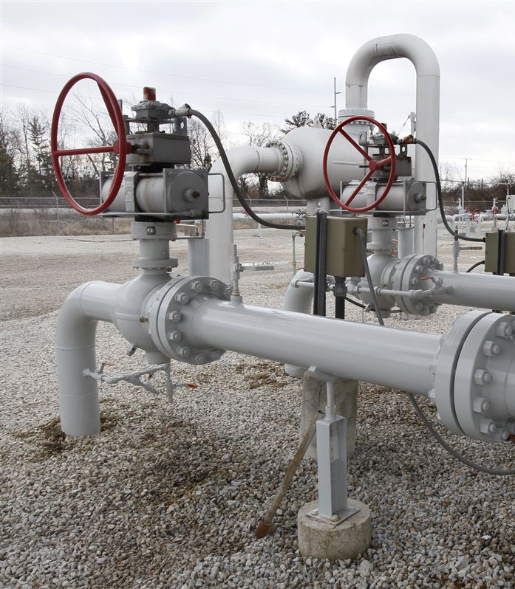
Part 192 – Key Sections
§192.634 Transmission lines: Onshore valve shut-off for rupture mitigation.
§192.635 Notification of potential rupture.
§192.636 Transmission lines: Response to a rupture; capabilities of rupture-mitigation valves (RMVs) or alternative equivalent technologies.

Slide 11
§192.634 Transmission lines: Onshore valve shut-off for rupture mitigation.
(a) Applicability:
New or Entirely Replaced: Transmission Lines and Type A Gathering Lines
≥ 6”
HCA
Class 3 or 4
Installed after April 10, 2023
Exempt:
Class 1 and 2 where PIR < 150’

Slide 12
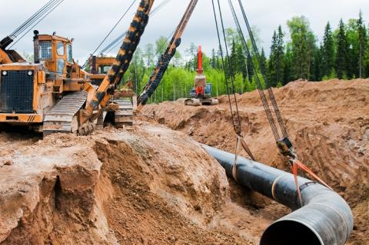
§192.3 Definitions.
Entirely replaced onshore transmission pipeline segments means, for the purposes of §§ 192.179 and 192.634, where 2 or more miles, in the aggregate, of onshore transmission pipeline have been replaced within any 5 contiguous miles of pipeline within any 24-month period.

Slide 13
§192.634 Transmission lines: Onshore valve shut-off for rupture mitigation.
(a)(1)
Shut-off segment. For purposes of this section, a ‘‘shut-off segment’’ means the segment of pipe located between the upstream valve closest to the upstream endpoint of the new or replaced Class 3 or Class 4 or HCA pipeline segment and the downstream valve closest to the downstream endpoint of the new or replaced Class 3 or Class 4 or HCA pipeline segment so that the entirety of the segment that is within the HCA or the Class 3 or Class 4 location is between at least two RMVs or alternative equivalent technologies.

Slide 14
Shut-off segment
Class 1
Class 3
Class 1
Notes:
As the class location unit is slid down to the end of the pipeline, the house count in the class location unit equals 7. This establishes a Class 1 area. Because higher class locations have been established on the upstream side of this last movement of the class location unit, only the very end is considered Class 1. As illustrated above, the higher class location sets the precedence, thus making the higher class location longer than a mile and the Class 2 and Class 1 shorter than a mile.
The overall class location is noted on the top and the individual movement of the corridor on the bottom.

Slide 15
§192.634 Transmission lines: Onshore valve shut-off for rupture mitigation.
(a)(2)
Shut-off segment valve spacing..
(i) Eight (8) miles for any Class 4 location,
(ii) Fifteen (15) miles for any Class 3 location, or
(iii) Twenty (20) miles for all other locations.

Slide 16

§192.635 Notification of potential rupture.
.
(a)…. ‘‘notification of potential rupture’’ refers to the notification of, or observation by, an operator (e.g., by or to its controller(s) in a control room, field personnel, nearby pipeline or utility personnel, the public, local responders, or public authorities)….

Slide 17
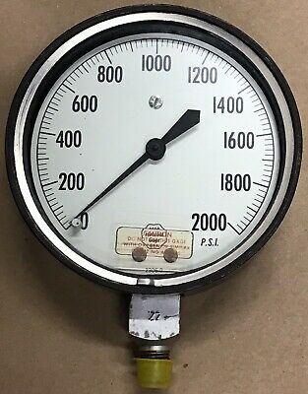
§192.635 Notification of potential rupture.
.
(a)…. Also includes:
Indication of a potential unintentional or uncontrolled release of a large volume of gas from a pipeline:
(1) Pressure loss outside of the pipeline’s normal operating pressures
(2) Flow rate change, pressure change, equipment function, or other pipeline instrumentation indication
(3) Rapid release of a large volume of gas, a fire, or an explosion in the immediate vicinity of the pipeline.

Slide 18
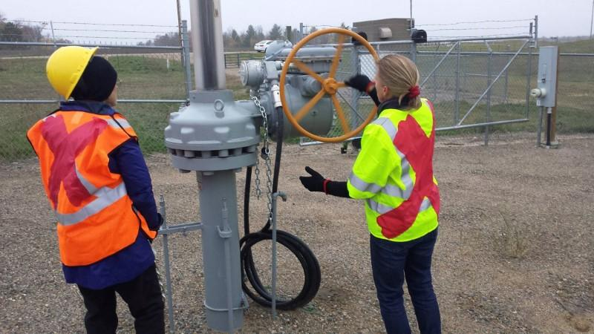
§192.636 Transmission lines: Response to a rupture; capabilities of rupture-mitigation valves (RMVs) or alternative equivalent technologies.
.
(b) Rupture identification and valve shut-off time. An operator must, as soon as practicable but within 30 minutes of rupture identification (§192.615(a)(12)), fully close any RMVs …..

Slide 19
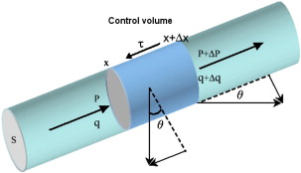
§192.636 Transmission lines: Response to a rupture; capabilities of rupture-mitigation valves (RMVs) or alternative equivalent technologies.
.
(f) Flow modeling for automatic shutoff valves. Prior to using an ASV as an RMV, an operator must conduct flow modeling for the shut-off segment and any laterals that feed the shut-off segment, so that the valve will close within 30 minutes or less….

Slide 20
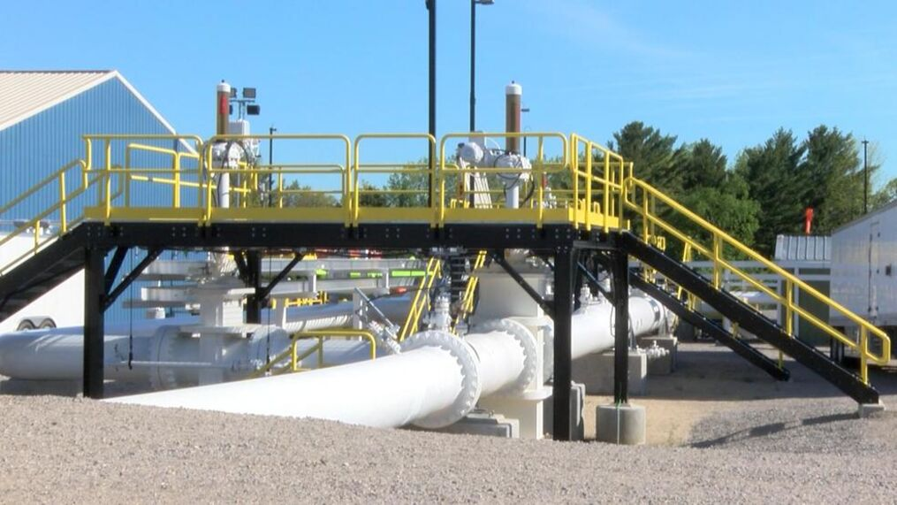
Part 195 – Key Sections
§195.417 Notification of potential rupture.
§195.418 Valves: Onshore valve shut-off for rupture mitigation..
§195.419 Valve capabilities.

Slide 21
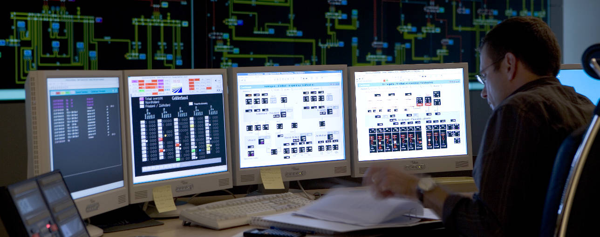
§195.417 Notification of potential rupture.
.
(a)…. notification of potential rupture refers to the notification of, or observation by, an operator (e.g., by or to its controller(s) in a control room, field personnel, nearby pipeline or utility personnel, the public, local responders, or public authorities)….

Slide 22
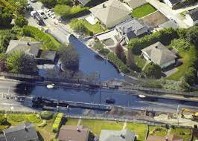
§195.417 Notification of potential rupture.
.
(a)…. Also includes:
Indication of a potential unintentional or uncontrolled release of a large volume of hazardous liquids from a pipeline:
(1) Pressure loss outside of the pipeline’s normal operating pressures
(2) Flow rate change, pressure change, equipment function, or other pipeline instrumentation indication
(3) Rapid release of a large volume of hazardous liquid, a fire, or an explosion in the immediate vicinity of the pipeline.

Slide 23
§195.418 Valves: Onshore valve shut-off for rupture mitigation.
(a) Applicability:
New or Entirely Replaced hazardous liquid pipelines
≥ 6”
Could affect or are in an HCA
Installed after April 10, 2023
Exempt: Regulated rural gathering that does not cross water. (§§ 195.11(b)(ii) & 195.260(e))

Slide 24
§195.2 Definitions.
Entirely replaced onshore hazardous liquid or carbon dioxide pipeline segments, for the purposes of §§ 195.258, 195.260, and 195.418, means where 2 or more miles of pipe, in the aggregate, have been replaced within any 5 contiguous miles within any 24-month period.

Slide 25
§195.418 Valves: Onshore valve shut-off for rupture mitigation.
(b)(1)
Shut-off segment. For purposes of this section, a ‘‘shut-off segment’’ means the segment of pipeline located between the upstream valve closest to the upstream endpoint of the replaced pipeline segment in the HCA or the pipeline segment that could affect an HCA and the downstream valve closest to the downstream endpoint of the replaced pipeline segment of the HCA……

Slide 26
Shut-off segment
HCA
Notes:
As the class location unit is slid down to the end of the pipeline, the house count in the class location unit equals 7. This establishes a Class 1 area. Because higher class locations have been established on the upstream side of this last movement of the class location unit, only the very end is considered Class 1. As illustrated above, the higher class location sets the precedence, thus making the higher class location longer than a mile and the Class 2 and Class 1 shorter than a mile.
The overall class location is noted on the top and the individual movement of the corridor on the bottom.

Slide 27
§195.418 Valves: Onshore valve shut-off for rupture mitigation.
(b)(2)
Shut-off segment valve spacing..
(i) Non - HVL: 15 miles, with a maximum distance not to exceed 7½ miles from the endpoints of a shut-off segment: or
(ii) HVLs: 7½ miles.

Slide 28
§195.260 Valves: Location.
(c) ….For pipeline segments that can not affect HCAs – 20 miles…
…….
(e) On each side of one or more adjacent water crossings that are more than 100 feet wide from high-water mark to high-water mark, as follows:
(1) Valves must be installed at locations outside of the 100-year flood plain or be equipped with actuators or other control equipment that is installed so as not to be impacted by flood conditions; and
(2) The maximum spacing interval between valves that protect multiple adjacent water crossings cannot exceed 1 mile in length.

Slide 29
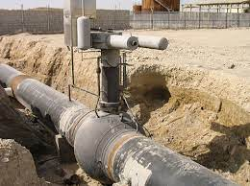
§195.419 Valve capabilities.
(b) Rupture identification and valve shut-off time. An operator must, as soon as practicable but within 30 minutes of rupture identification (§195.402(e)(4)), fully close any RMVs …..

Slide 30
§195.419 Valve capabilities.
(f) Flow modeling for automatic shutoff valves. Prior to using an ASV as an RMV, an operator must conduct flow modeling for the shut-off segment and any laterals that feed the shut-off segment, so that the valve will close within 30 minutes or less….

Slide 31
Other Key Changes for Transmission/Distribution/Hazardous Liquid Pipeline Systems
§192.615 / §192.402 - Emergency plans
Establishing and maintaining adequate means of communication with the appropriate public safety answering point (i.e., 9–1–1 emergency call center)…
§192.617 / §192.402 - Investigation of failures
Post-failure and incident lessons learned. Each operator must develop, implement, and incorporate lessons learned from a post-failure or incident review…

Slide 32
Other Key Changes for Transmission/Hazardous Liquids
§192.617 / §195.402
Analysis of rupture and valve shutoffs.
….conduct a post-incident analysis of all of the factors that may have impacted the release volume and the consequences of the incident and identify and implement operations and maintenance measures to prevent or minimize the consequences of a future incident.
Rupture post-failure and incident summary.
….complete a summary of the post-failure or incident review required by paragraph (c) of this section within 90 days of the incident…

Slide 33
Other Key Changes for Transmission
§192.610 Change in class location: Change in valve spacing
(a)….2 miles or more in 5 miles – Install RMVs
(b)…Less than 2 miles in 5 miles - Meet valve spacing under §192.179 or install RMVs up and downstream of replaced segment.
(c)…1000’ within 1 mile – If valve spacing is met, not valve required.

Slide 34
Other Key Changes for Hazardous Liquids
§195.420 Valve Maintenance
(a) Each operator shall maintain each valve that is necessary for the safe operation of its pipeline systems in good working order at all times.
(b) Each operator must, at least twice each calendar year, but at intervals not exceeding 7½ months, inspect each mainline valve to determine that it is functioning properly…

